Slide 1
VOCABULAIRE LES PRÉFIXES

Slide 2
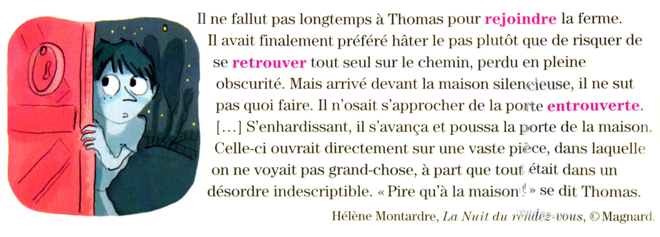
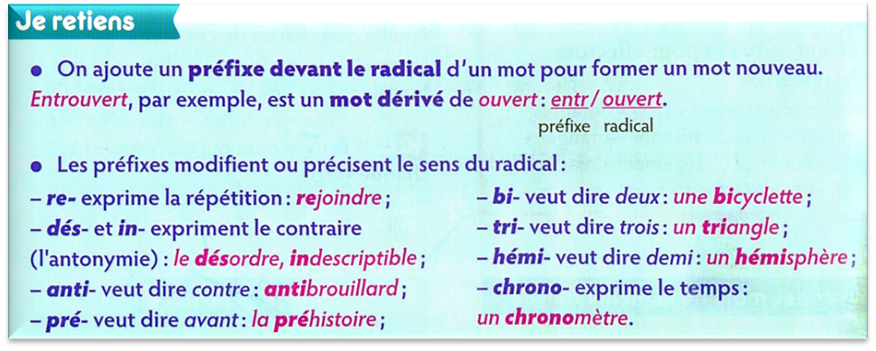
Cherchons
……………………………………………………………………………………………………………………………………………………………………………………………………………………………………………………………………………………………………………………………………………………………………………………………………………………………………………………………………………………………………………………………………………………………….

Slide 3
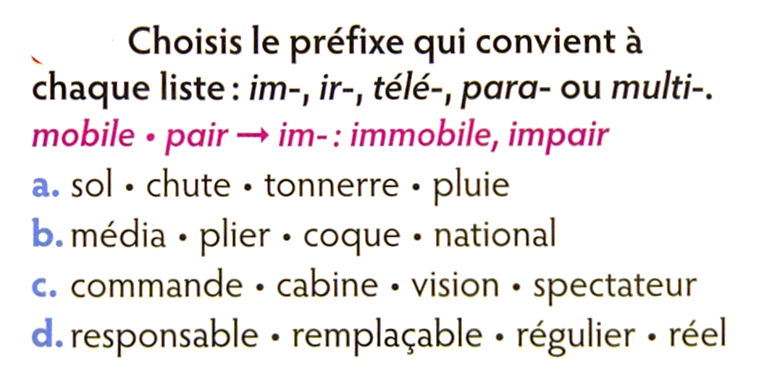
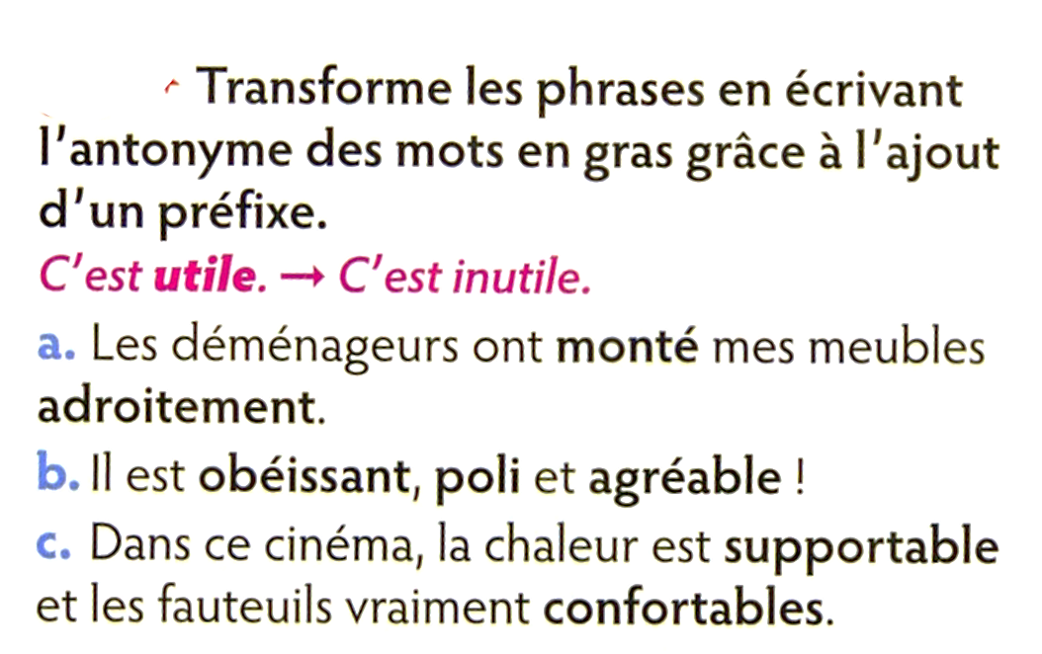
a…………………………………………………………………………………………………………………………………………………………………………………b…………………………………………………………………………………………………………………………………………………………………………………
c……………………………………………………………………………………………………………………………………………………………………………………d………………………………………………………………………………………………………………………………………………………………………………..
a…………………………………………………………………………………………………………………………………………………………………………………b…………………………………………………………………………………………………………………………………………………………………………………
c……………………………………………………………………………………………………………………………………………………………………………………

Slide 4
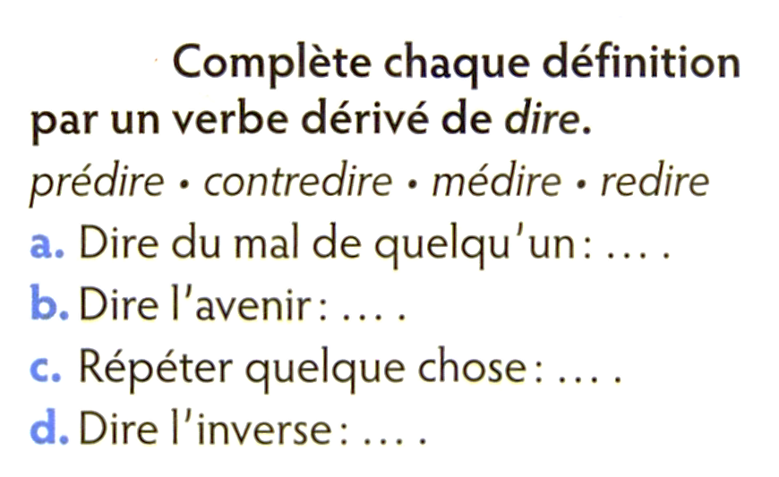
a…………………………………………………………………………………………………………………………………………………………………………………b…………………………………………………………………………………………………………………………………………………………………………………
c……………………………………………………………………………………………………………………………………………………………………………………d………………………………………………………………………………………………………………………………………………………………………………..

